Slide 1
COMP1860 Building our Digital World: Computer Systems & Architecture
S1.W1.L2 - Computer Architecture & History of Computing Part 2
Dr James Dyer

Slide 2
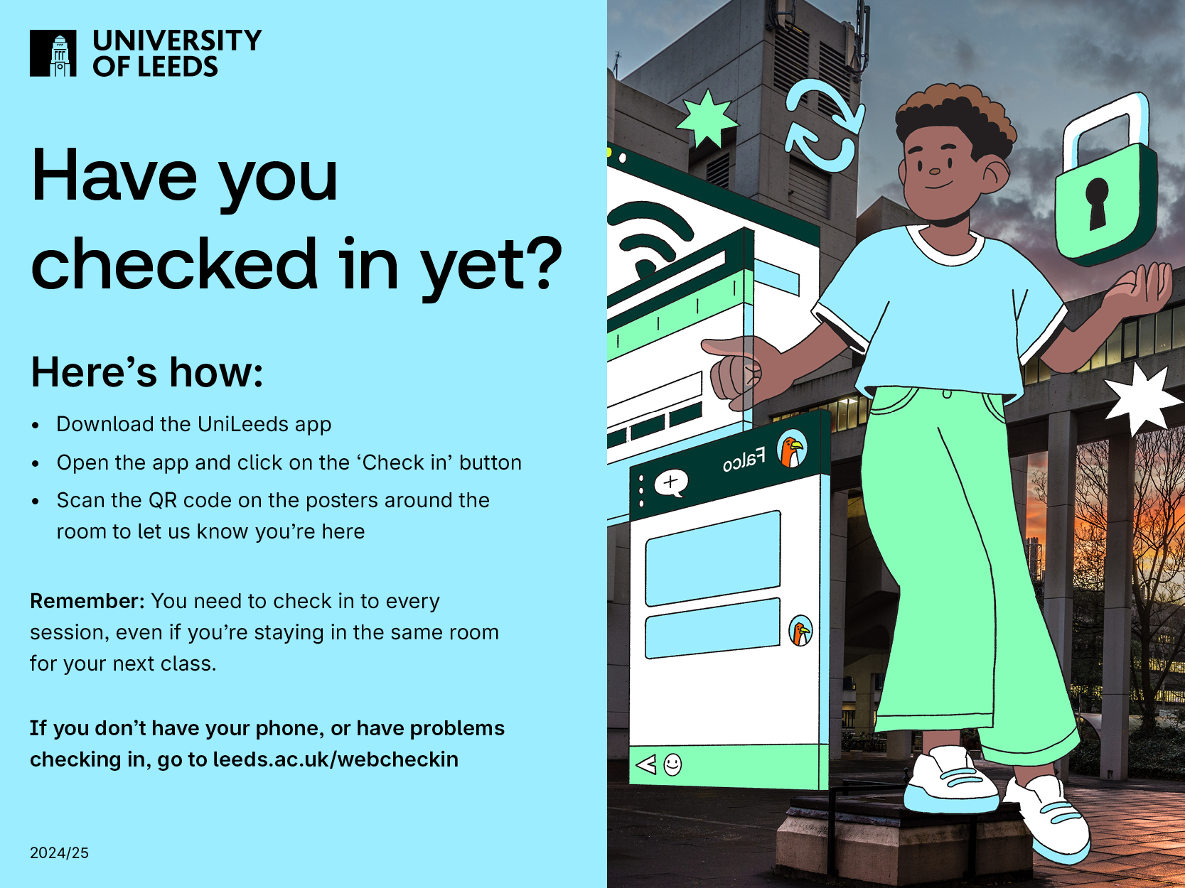

Slide 3
Learning Outcomes
Recognise the contributions of individuals and organisations in the computing field.
Explain trends in the history of the computing field.
Describe the basic building blocks of computers and their role in the historical development of computer architecture.

Slide 4
Text Book
This lecture is based on chapter 1 of Stallings. Computer Organisation & Architecture
  It covers 1.3 from Transistors onward, 1.4, 1.5, 1.6

Slide 5
Overview
Building blocks of computer hardware
History of computer hardware (part 2)
Instruction Set Architectures
Embedded Systems
Parallelism
Hardware & Software

Slide 6
Building Blocks of Computers

Slide 7
Computer Building Blocks
Logic Gates
  implements a simple Boolean or logical function
  For example, an AND gate with inputs A and B and output C implements the expression IF A AND B ARE TRUE THEN C IS TRUE.
  Controls data flow like canal gate controls water flow
Memory Cell
  store one bit of data
  can be in one of two stable states at any time
By interconnecting large numbers of these fundamental devices, we can construct a computer.

Slide 8
Function & Structure
Data storage – provided by memory cells
Data processing – provided by gates
Data movement – the paths among components are used to move data from memory to memory and from memory through gates to memory
Control – the paths among components can carry control signals
  Gate has two data inputs plus a control signal input that activates the gate.
  When the control signal is ON, the gate performs its function on the data inputs and produces a data output.
  Conversely, when the control signal is OFF, no output produced
  Memory cell stores the bit that is on input lead when the WRITE control signal is ON
  Sends bit on output lead that is in the cell READ control signal is ON.

Slide 9
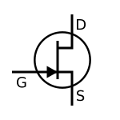
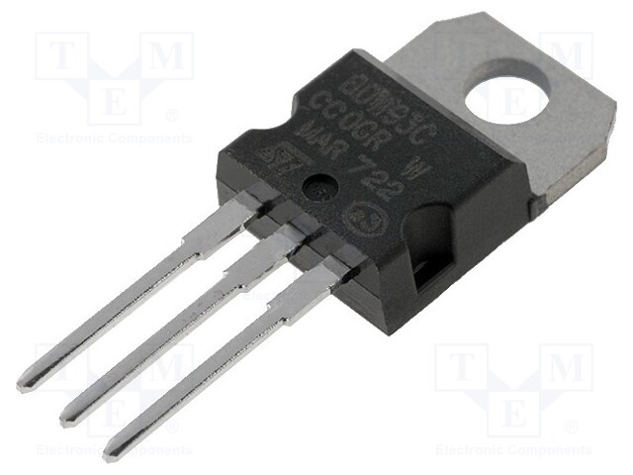
Transistors
The fundamental building block of gates and memory cells
  Wired together
Semiconductor
  In its normal state the material may be nonconductive or conductive
Changes state when voltage is applied to the gate
Discrete component
  A single, self-contained transistor
  Were manufactured separately, packaged in their own containers, and soldered or wired together onto circuit boards
History
  Proposed in 1926
  First manufactured in 1947
  First metal oxide semiconductor transistor in 1960

Slide 10
Integrated Circuit
Transistors had to be soldered to circuit board
  Expensive and cumbersome to manufacture
Created problem for computer industry.
  Early second-generation computers contained about 10,000 transistors.
  This figure grew to the hundreds of thousands, making the manufacture of newer, more powerful machines increasingly difficult.
Integrated circuits developed to counter this
  Miniaturisation
  Lots of transistors and connections between them on a tiny sliver of silicon
  First IC produced in 1958 by Jack Kilby at Texas Instruments

Slide 11
Integrated Circuit
Wafer of silicon is divided into a matrix of small areas, each a few millimeters square.
Each chip consists of many gates and/or memory cells plus a number of input and output attachment points.
This chip is then packaged in housing that protects it and provides pins for attachment to devices beyond the chip.
Packages can then be interconnected on a printed circuit board to produce larger and more complex circuits

Slide 12
Integrated Circuit

Slide 14
Moore’s Law
1965; Gordon Moore – co-founder of Intel
Observed number of transistors that could be put on a single chip was doubling every year
  The pace slowed to a doubling every 18 months in the 1970’s but has sustained that rate ever since
Consequences of Moore’s law:
  The cost of computer logic and memory circuitry has fallen at a dramatic rate
  The electrical path length is shortened, increasing operating speed
  Computer becomes smaller, more convenient to use in a variety of environments
  Reduction in power and cooling requirements
  Fewer inter-chip connections

Slide 15
Break

Slide 16
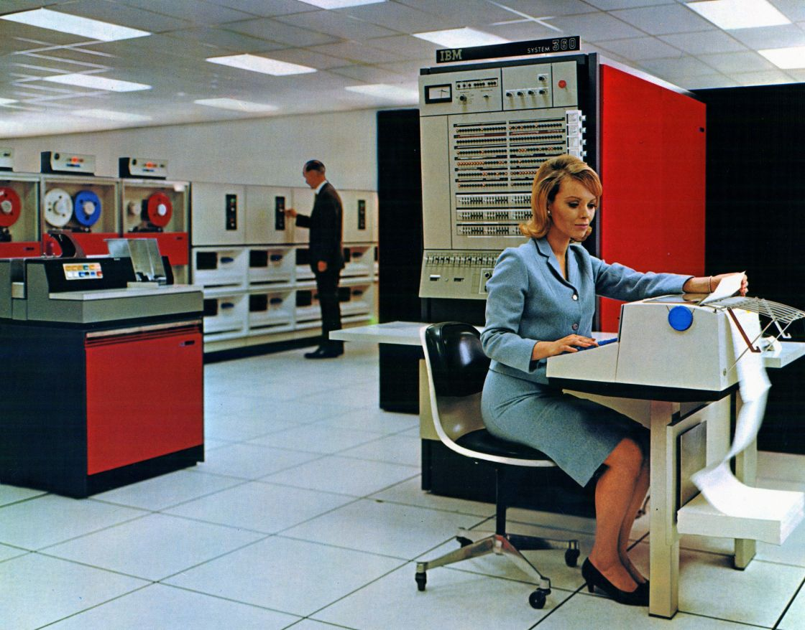
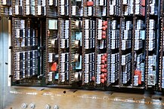
Mainframe Computers
First commercial computers of 1950s and 1960s
Components typically filled entire room
IBM System/360 popular mainframe
  See below
System 360 circuit boards in situ

Slide 17
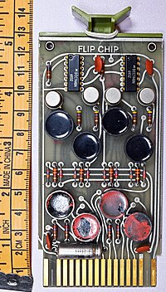
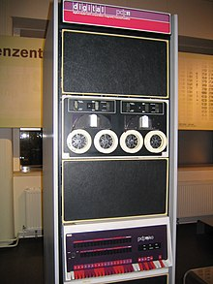
Minicomputers
ICs made computers faster, more powerful, smaller, and cheaper
The next form factor was the minicomputer
  From mid 1960s
  Components all fit in a cabinet
  Defined in 1970 as costing less than $25,000
  PDP-8 was $16000, IBM System/360 mainframe was $100K+
Digital Equipment Corporation (DEC) PDP and VAX series popular minicomputers
Flip Chip Module
PDP-11

Slide 18
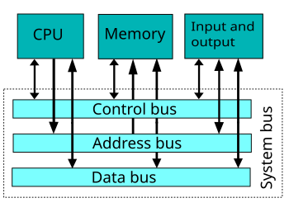
System Bus
At this time, the system bus evolved
  Used in a lot of minicomputers
  Provides for communication among processors, main memory, and I/O modules
Replaced bundles of wires
  Particularly for I/O
  Cheaper and easier to manufacture
Allowed for modularity
  New I/O modules can be easily added

Slide 19
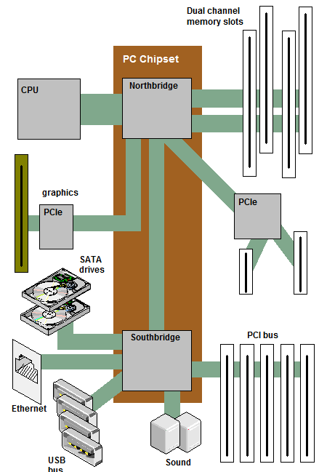
Modern PC System Bus

Slide 20
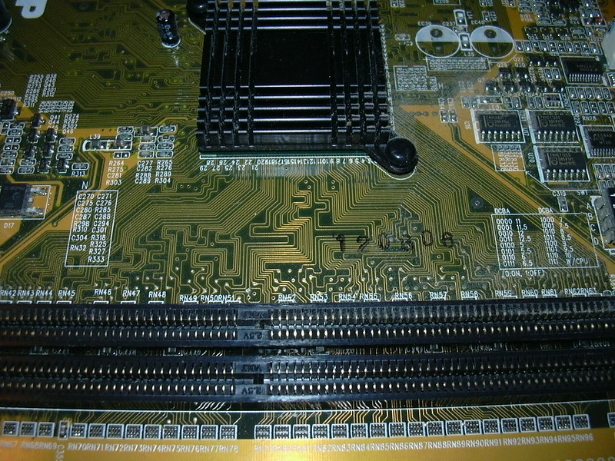
Memory Bus
Copper tracks are memory buses between memory modules and Northbridge

Slide 21
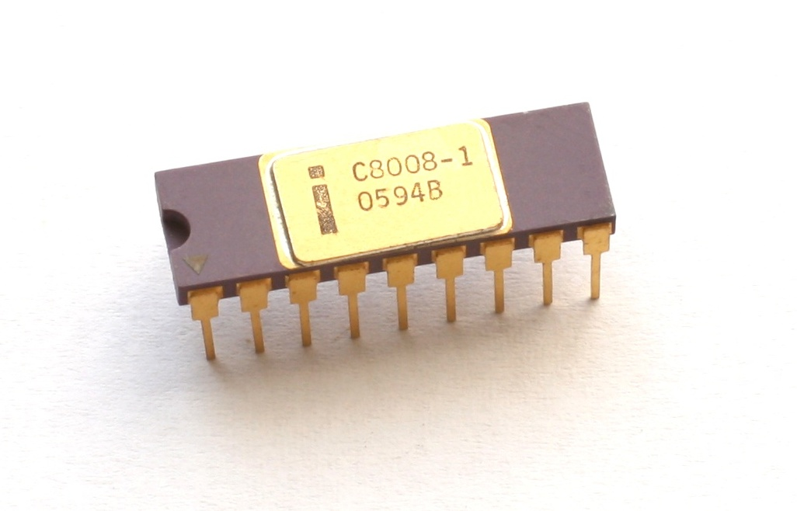
Microprocessors
  Invention that brought about desktop and handheld computing
  Contains a processor(s) on a single chip
  Fastest general-purpose processors
  Modern chips contains multiple processors (cores)
Intel 8008 microprocessor

Slide 22
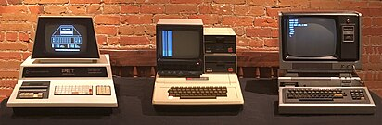
Microcomputers
By the mid 1970s, machines could be housed in a small box
These devices were cheap enough that individuals could buy them.
Used standard processors
  E.g. Intel 8080
  Motorola 6800
The Commodore PET, the Apple II, and the TRS-80 Model I

Slide 23
Instruction Sets

Slide 24
Instruction Set Architecture (ISA)
In general, an ISA defines:
  supported instructions
  data types
  Registers
  the hardware support for managing main memory
  the input/output model of implementations of the ISA
2 classifications
  CISC – Complex Instruction Set Computer
  RISC – Reduced Instruction Set Computer

Slide 25
x86 ISA
Instruction Set Architecture called x86 after Intel 8086 processor (first in family)
AMD processors compatible with x86 instruction set
Complex Instruction Set Computer (CISC)
  Number of instructions increased as processors in family added more features
  Lots of instruction set extensions to handle special features
    Virtualization
    Cryptography, etc.
x86 ISA for 64-bit machines often called x86_64 or x64

Slide 26
RISC ISA
Reduced instruction set computer
  Small number of basic instructions, e.g. load, add, multiply
  All features implemented using these basic instructions
    Compilation is more complicated
Several RISC ISA standards
  RISC V
    Open standard
  ARM
    Amber (ARM v2) is open source
  OpenRISC
    Another open standard

Slide 27
Break

Slide 28
Embedded Systems
The use of electronics and software within a product
Billions of computer systems are produced each year that are embedded within larger devices
Today many devices that use electric power have an embedded computing system
Tightly coupled to environment
  Real-time constraints such as required speeds of motion, required precision of measurement, and required time durations
  If multiple activities managed simultaneously imposes more complex real-time constraints

Slide 29
Embedded Systems: Organisation
Differ from the typical desktop or laptop computer:
  interfaces to measure (sensors), manipulate (actuators), and interact with environment..
  The diagnostic port may be used for diagnosing the system that is being controlled—not just for diagnosing the computer.
  Software often has a fixed function and is specific to the application.
  Optimized for energy, code size, execution time, weight and dimensions, and cost.
Similar:
  Ability to upgrade to fix bugs, to improve security, and to add functionality, has become very important
  Recent development has been embedded system platforms that support a wide variety of apps. Examples: smartphones, smart TVs, smart speakers.

Slide 30
Internet of Things
Term that refers to the expanding interconnection of smart devices, ranging from appliances to tiny sensors
Is primarily driven by embedded devices
Generations of deployment culminating in the IoT:
  PCs, servers, routers, firewalls, and so on, bought as IT devices by enterprise IT people and primarily using wired connectivity
  Operational technology (OT)
  Machines/appliances with embedded IT built by non-IT companies, such as medical machinery, SCADA, process control, and kiosks, bought as appliances by enterprise OT people and primarily using wired connectivity
  Smartphones, tablets, and eBook readers bought as IT devices by consumers exclusively using wireless connectivity and often multiple forms of wireless connectivity
  Sensor/actuator technology
  Single-purpose devices bought by consumers, IT, and OT people exclusively using wireless connectivity, generally of a single form, as part of larger systems

Slide 31
Microcontrollers
Single chip that contains:
  Processor,
  non-volatile memory for the program (ROM)
  volatile memory for input and output (RAM)
  Clock
  I/O control unit.
Smaller - much lower silicon area
Higher energy efficiency
Used to control system
  E.g. machinery
Used in embedded devices

Slide 32
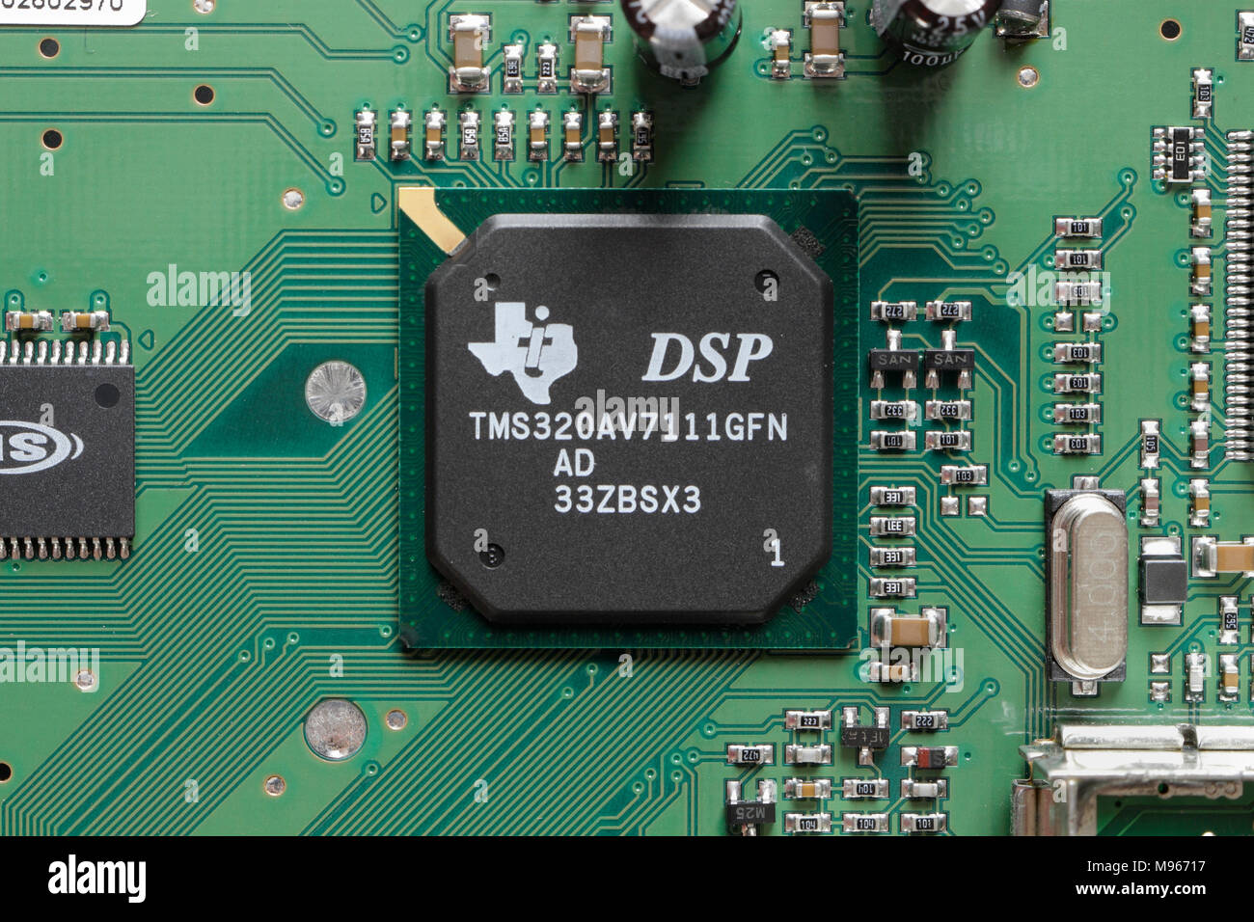
Digital Signal Processors (DSPs)
  Deal with streaming signals such as audio or video
  Used to be embedded in I/O devices like modems
  Encoding/decoding (codecs)
  Provide support for encryption and security

Slide 33
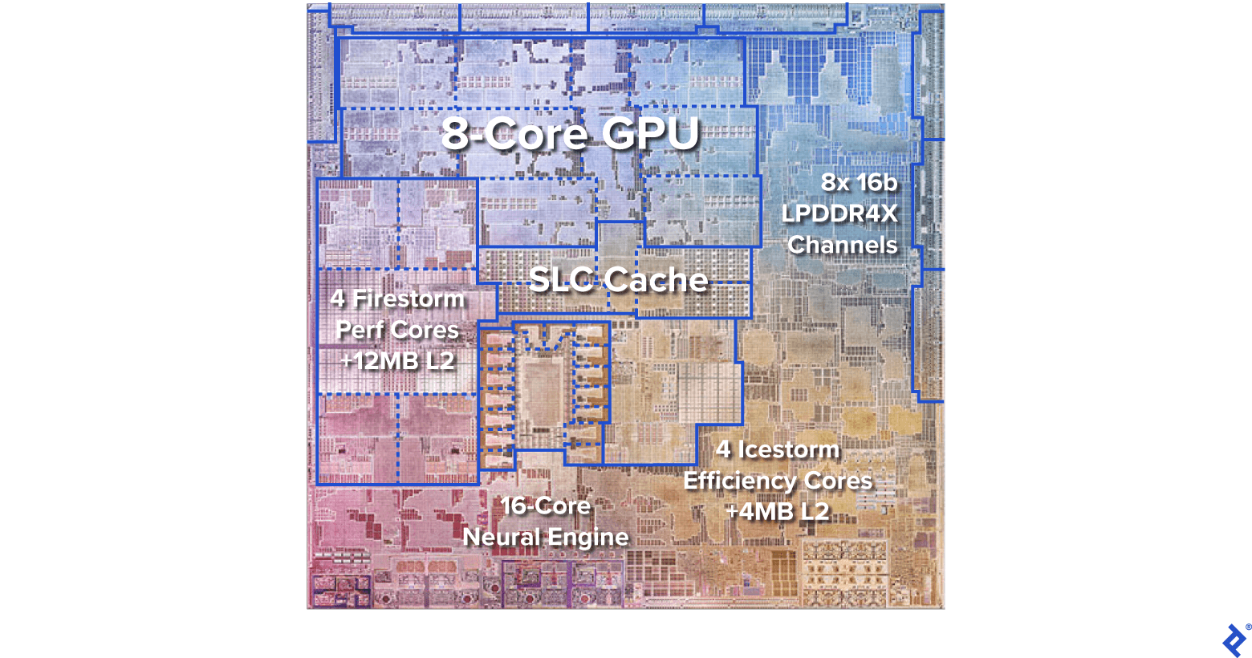
System-on-chip (SoC)
Chip contains major components of a computer
  Processor
  Memory
  I/O
  GPU
Examples: Apple A & M series, Nvidia Tegra, Qualcomm Snapdragon
Used in mobile devices
  Smartphones
  Tablets
  Game consoles
Apple M1

Slide 34
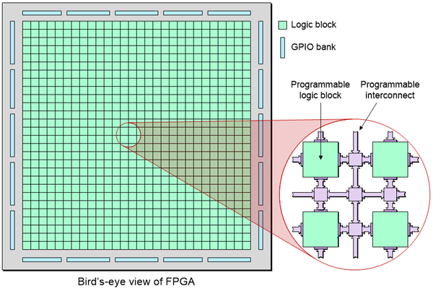
Field Programmable Gate Array (FPGA)
Logic units can be configured
Circuit can be programmed
Can be reprogrammed for different purpose

Slide 35
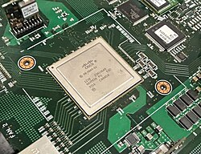
Application-Specific Integrated Circuit (ASIC)
IC customised for specific use
E.g., highly efficient video codec
Modern ASICs are typically microcontrollers/SoCs
FPGAs sometime used in development of ASICs
A packet processing ASIC inside an Ethernet switch

Slide 36
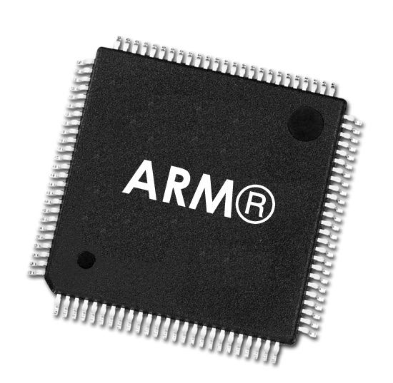
ARM Processors
Embedded systems need cheap, efficient processors
ARM design processor and architecture profiles
  Licenses design to manufacturers
RISC based
  Reduced Instruction Set Computer
  Small set of processor instructions
High speed
Energy efficient
  Low power
  Low heat generation

Slide 37
ARM Architecture Profiles
Cortex-A
  Intended for mobile devices: smartphones, tablets, etc.
Cortex-R
  Intended for real-time applications
  Timing important
  Fast response to events
Cortex-M
  Intended for microcontrollers

Slide 38
Example Cortex-M architecture
Core and memory:
  Cortex-M3 processor
  Static RAM (SRAM) data memory
  Flash memory for storing program instructions and nonvarying application data.
Energy management
  Manages the various low-energy modes of operation
Security
  The chip includes a hardware implementation of the Advanced Encryption Standard (AES).
32-bit bus : Connects all of the components on the chip.
Peripheral bus
  Allows modules to communicate directly with each other without involving the processor
  Supports timing-critical operation and reduces software overhead.

Slide 39
Parallelism

Slide 40
Parallelism
Tasks can be split up into smaller tasks which can be assigned to processor
E.g., assembly line: each worker completes one step of the overall task and passes completed item to next worker while taking next item to work on
A pipeline is computing version of this (streaming)
E.g., same task to be repeated on lots of data: single instruction, multiple data (SIMD)
  Can divide data up and assign each batch to different processor
Speeds up execution because tasks are running concurrently rather than consecutively
Modern CPUs have multiple cores to try and exploit parallelism for speed up

Slide 41
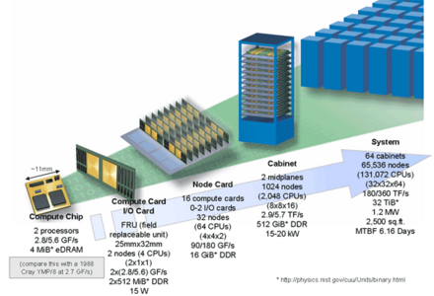
Supercomputers
Massively parallel computer
  Each processing unit works on small piece of overall task
Used for computationally intensive tasks
  Weather forecasting
  Molecular modelling,
  Big data analysis, etc.
Contain thousands of processing units (compute nodes)
Use custom networking to connect compute nodes
Hierarchical design of IBM Blue/Gene processing units

Slide 42
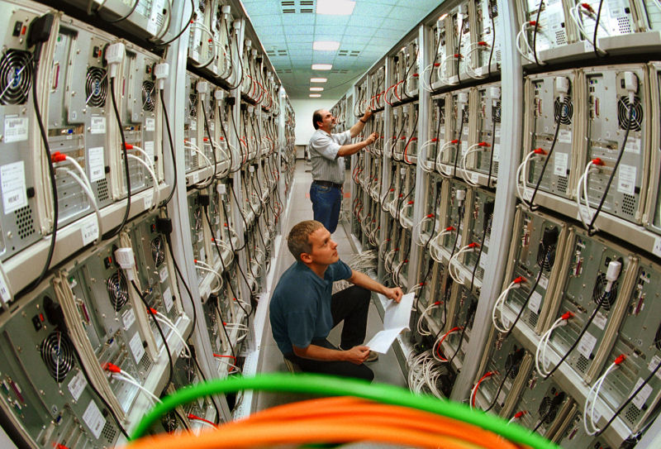
Computing Clusters
Also, massively parallel
Off-the-shelf components as compute nodes
  Servers
  GPUs
Standard networking to connect compute nodes
Control and scheduling is managed by software
Cloud computing uses clusters

Slide 43
Graphical Processing Units (GPUs)
  Provide efficient computation on arrays of data using Single-Instruction Multiple Data (SIMD) techniques pioneered in supercomputers
  No longer used just for rendering advanced graphics
  Also used for general numerical processing
      Physics simulations for games
      Computations on large spreadsheets
      AI model training

Slide 44
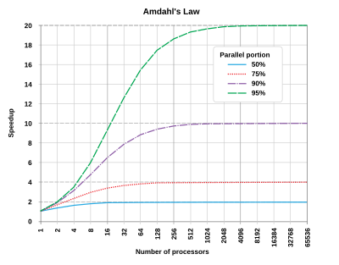
Amdahl’s Law
Amdahl’s Law
  "the overall performance improvement gained by optimizing a single part of a system is limited by the fraction of time that the improved part is actually used“
So, we do not get a speed up simply by adding more processors
Depends on how the task can be parallelised

Slide 45
Break

Slide 46
Hardware & Software

Slide 47
Hardware & Software
In order to perform tasks, we need programs
Machine instructions are the way the hardware is controlled to perform a task
Programs written as machine instructions become increasingly complex
Instead provide programmers with interfaces using high-level programming language
  Allows hardware to be controlled without providing set of machine instructions
  High-level program is translated to machine instructions
    Compilation
    Interpretation

Slide 48
Hardware & Software Structure
Applications
  Programs users interact with
Utilities
  System programs designed to perform certain functions
Operating System
  Provides interface to system hardware
Libraries
  Provides interface to OS
Notes:
The hardware and software used in providing applications to a user can be viewed in a layered or hierarchical fashion, as depicted in Figure 2.1 . The user of those applications, the end user, generally is not concerned with the details of computer hardware. Thus, the end user views a computer system in terms of a set of applications. An application can be expressed in a programming language and is developed by an application programmer. If one were to develop an application program as a set of machine instructions that is completely responsible for controlling the computer hardware, one would be faced with an overwhelmingly complex undertaking. To ease this chore, a set of system programs is provided. Some of these programs are referred to as utilities, or library programs. These implement frequently used functions that assist in program creation, the management of files, and the control of I/O devices. A programmer will make use of these facilities in developing an application, and the application, while it is running, will invoke the utilities to perform
certain functions. The most important collection of system programs comprises the OS. The OS masks the details of the hardware from the programmer and provides the programmer with a convenient interface for using the system. It acts as mediator, making it easier for the programmer and for application programs to access and use those facilities and services.

Slide 49
Operating System
A program that controls the execution of application programs
An interface between applications and hardware
Main objectives of an OS:
Convenience
Efficiency
Ability to evolve
Notes:
An OS is a program that controls the execution of application programs and acts as an interface between applications and the computer hardware. It can be thought of as having three objectives:
• Convenience: An OS makes a computer more convenient to use.
• Efficiency: An OS allows the computer system resources to be used in an efficient manner.
• Ability to evolve: An OS should be constructed in such a way as to permit the effective development, testing, and introduction of new system functions without interfering with service.

Slide 50
Operating System Services
Program development
Program execution
Access I/O devices
Controlled access to files
System access
Error detection and response
Accounting
Notes:
Briefly, the OS typically provides services in the following areas:
• Program development: The OS provides a variety of facilities and services, such as editors and debuggers, to assist the programmer in creating programs.
Typically, these services are in the form of utility programs that, while not strictly part of the core of the OS, are supplied with the OS and are referred to
as application program development tools.
• Program execution: A number of steps need to be performed to execute a program. Instructions and data must be loaded into main memory, I/O devices
and files must be initialized, and other resources must be prepared. The OS handles these scheduling duties for the user.
• Access to I/O devices: Each I/O device requires its own peculiar set of instructions or control signals for operation. The OS provides a uniform interface
that hides these details so that programmers can access such devices using simple reads and writes.
• Controlled access to files: For file access, the OS must reflect a detailed understanding of not only the nature of the I/O device (disk drive, tape drive) but
also the structure of the data contained in the files on the storage medium. In the case of a system with multiple users, the OS may provide protection
mechanisms to control access to the files.
• System access: For shared or public systems, the OS controls access to the system as a whole and to specific system resources. The access function must
provide protection of resources and data from unauthorized users and must resolve conflicts for resource contention.
• Error detection and response: A variety of errors can occur while a computer system is running. These include internal and external hardware errors, such
as a memory error, or a device failure or malfunction; and various software errors, such as division by zero, attempt to access forbidden memory location,
and inability of the OS to grant the request of an application. In each case, the OS must provide a response that clears the error condition with the least
impact on running applications. The response may range from ending the program that caused the error, to retrying the operation, to simply reporting the
error to the application.
• Accounting: A good OS will collect usage statistics for various resources and monitor performance parameters such as response time. On any system, this
information is useful in anticipating the need for future enhancements and in tuning the system to improve performance. On a multiuser system, the information
can be used for billing purposes.

Slide 51
Key Interfaces
Instruction set architecture (ISA)
  Machine instructions
  Some programs may access ISA directly (contain machine instructions)
Application binary interface (ABI)
  System call interface to OS and hardware
  Typically implemented as libraries or device drivers
  Allows programs to be independent of hardware and OS changes – binary code compatibility
Application programming interface (API)
  High-level programming language interface to hardware resources and system services
  Implemented as libraries
  Allows program to be ported to other systems that support same API – source code compatibility
Notes:
Three key interfaces in a typical computer system:
• Instruction set architecture (ISA) : The ISA defines the repertoire of machine
language instructions that a computer can follow. This interface is the boundary
between hardware and software. Note that both application programs
and utilities may access the ISA directly. For these programs, a subset of the
instruction repertoire is available (user ISA). The OS has access to additional
machine language instructions that deal with managing system resources
(system ISA).
• Application binary interface (ABI) : The ABI defines a standard for binary
portability across programs. The ABI defines the system call interface to
the operating system and the hardware resources and services available in a
system through the user ISA.
• Application programming interface (API) : The API gives a program access
to the hardware resources and services available in a system through the user
ISA supplemented with high-level language (HLL) library calls. Any system
calls are usually performed through libraries. Using an API enables application
software to be ported easily, through recompilation, to other systems that
support the same API.

Slide 52
The Operating System as Resource Manager
The OS is responsible for controlling the use of a computer’s resources, such as I/O, main and secondary memory, and processor execution time
Portion of OS, the kernel is in main memory
Remainder is user programs and data
Notes:
The OS is responsible for controlling the use of a computer’s resources, such as I/O, main and secondary memory, and processor execution time. But this control is exercised in a curious way. Normally, we think of a control mechanism as something external to that which is controlled, or at least as something that is a distinct and separate part of that which is controlled. (For example, a residential heating system is controlled by a thermostat, which is separate from the heat-generation and heat distribution apparatus.)
Figure 2.2 suggests the main resources that are managed by the OS. A portion of the OS is in main memory. This includes the kernel , or nucleus , which contains the most frequently used functions in the OS and, at a given time, other portions of the OS currently in use. The remainder of main memory contains user programs and data. The memory management hardware in the processor and the OS jointly control the allocation of main memory. The OS decides when an I/O device can be used by a program in execution and controls access to and use of files. The processor itself is a resource, and the OS must determine how much processor time is to be devoted to the execution of a particular user program

Slide 53
OS Evolution
A major OS will evolve over time for a number of reasons:
Hardware upgrades
  E.g. graphical interfaces
New types of hardware
New services
Fixes
Notes:
A major OS will evolve over time for a number of reasons:
• Hardware upgrades plus new types of hardware: For example, early versions
of UNIX and the Macintosh OS did not employ a paging mechanism because
they were run on processors without paging hardware. Subsequent versions
of these operating systems were modified to exploit paging capabilities. Also,
the use of graphics terminals and page-mode terminals instead of line-at-a time
scroll mode terminals affects OS design. For example, a graphics terminal
typically allows the user to view several applications at the same time through
“windows” on the screen. This requires more sophisticated support in the OS.
• New services: In response to user demand or in response to the needs of system
managers, the OS expands to offer new services. For example, if it is found
to be difficult to maintain good performance for users with existing tools, new
measurement and control tools may be added to the OS.
• Fixes: Any OS has faults. These are discovered over the course of time and
fixes are made. Of course, the fix may introduce new faults.
The need to change an OS regularly places certain requirements on its design.
An obvious statement is that the system should be modular in construction, with
clearly defined interfaces between the modules, and that it should be well documented.
For large programs, such as the typical contemporary OS, what might be
referred to as straightforward modularization is inadequate [DENN80a]. That is,
much more must be done than simply partitioning a program into modules. We
return to this topic later in this chapter.

Slide 54
Summary
Building blocks of computer hardware
History of computer hardware (part 2)
Instruction Set Architectures
Embedded Systems
Parallelism
Hardware & Software

